Slide 1

Bambini e vaccini
ANTI-COVID:
PRO E CONTRO
Sala "Caduti di Nassirya" del Palazzo Madama - Senato della Repubblica
16-6-2021 ore 18

Slide 2
E’ Sicuro al 100% vaccinare I bambini per SarsCov2?
TIPOLOGIE DI VACCINI
organismi attenuati → come i vaccini per la poliomielite di Sabin (OPV)^{[9]}, febbre Gialla, morbillo, parotite, rosolia, varicella, rotavirus e vaiolo.
organismi inattivati o uccisi → come i vaccini per la rabbia, l'antipoliomielite di Salk (IPV)^{[9]}, antinfluenzali, pertosse, colera, epatite A, febbre tifoide e peste;
antigeni purificati (o vaccini a subunità), → come i vaccini (costituiti da anatossine) contro il tetano o la difterite;
antigeni ricombinanti e peptidi sintetici → come il vaccino contro l'epatite B;
carriers proteici coniugati agli antigeni → che consentono una maggiore risposta immunitaria e vengono spesso utilizzati nei vaccini contenenti antigeni polisaccaridici (più difficili da riconoscere per i linfociti) quali quelli contro meningococchi, pneumococchi ed Haemophilus influenzae di tipo B.
DNA o RNA, come diversi vaccini contro il SARS-CoV2;
Dalla loro scoperta, i vaccini hanno subito notevoli sviluppi, e ad oggi le tipologie di vaccini approvate ed utilizzate sono:
QUESTO ARGOMENTO E’ ESTREMAMENTE DELICATO, IN QUANTO OLTRE AD UN VACCINO PER UN NUOVO PATOGENO SONO STATE UTILIZZATE TECNOLOGIE VACCINALI MAI USATE FINO AD ORA A TALE SCOPO

Slide 3
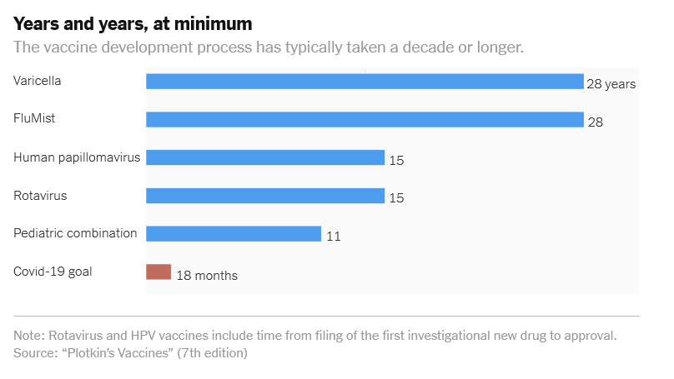

Slide 4

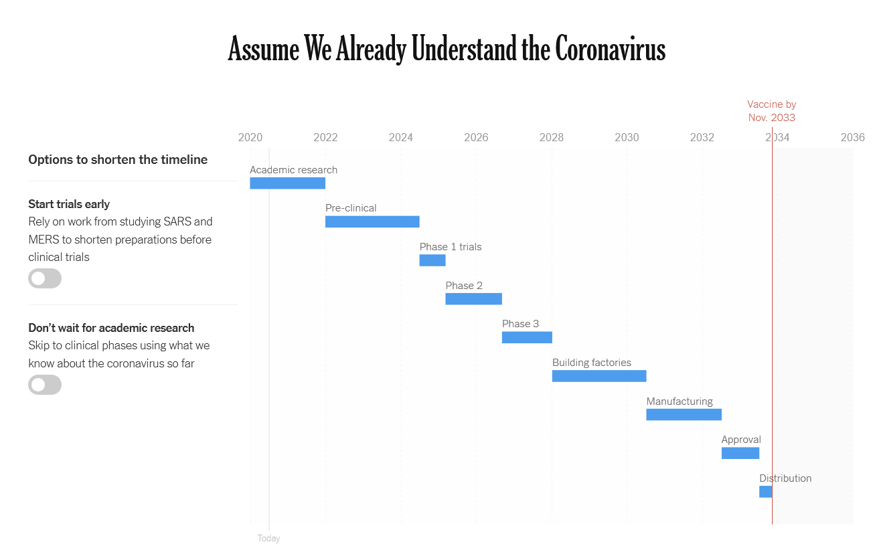

Slide 5
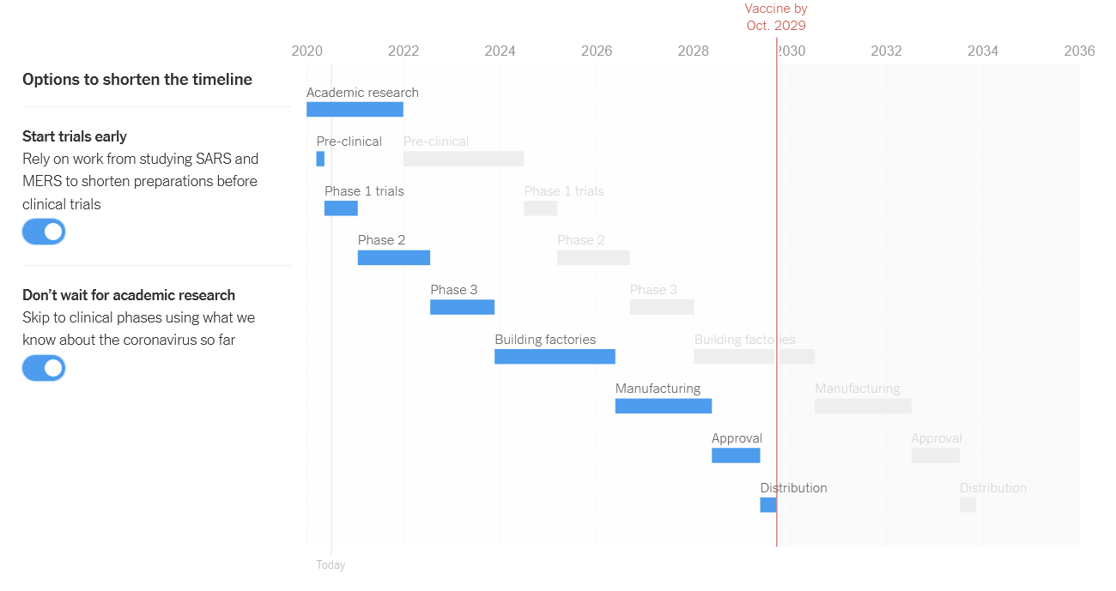

Slide 6
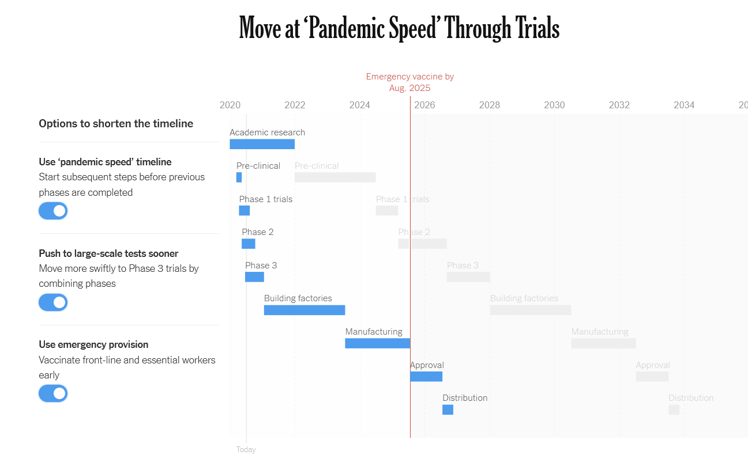

Slide 7
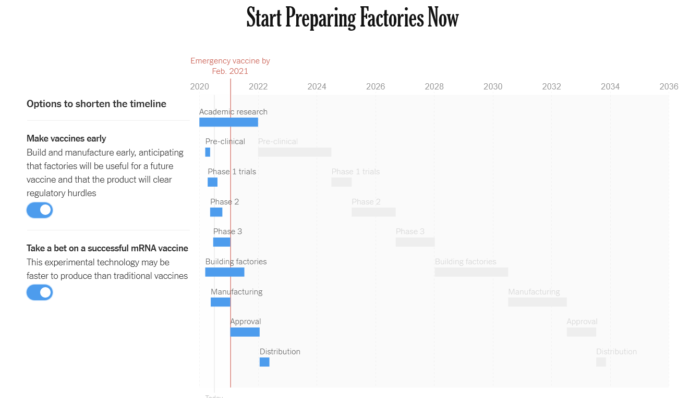

Slide 8
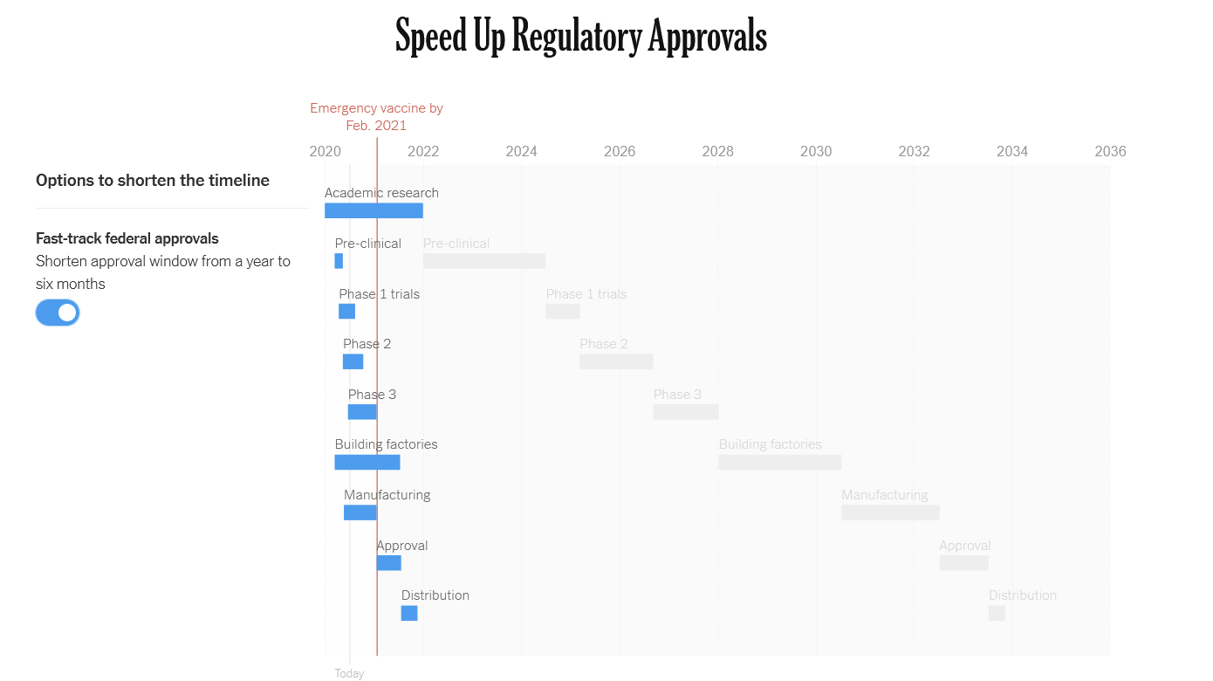

Slide 9
EMA:
NON CI SONO LINEE GUIDA PER VACCINI mRNA

Slide 10
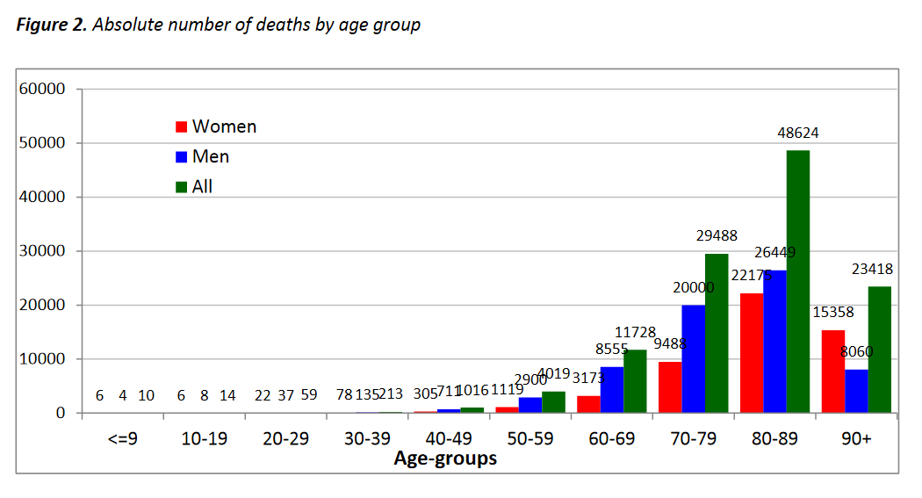

Slide 11
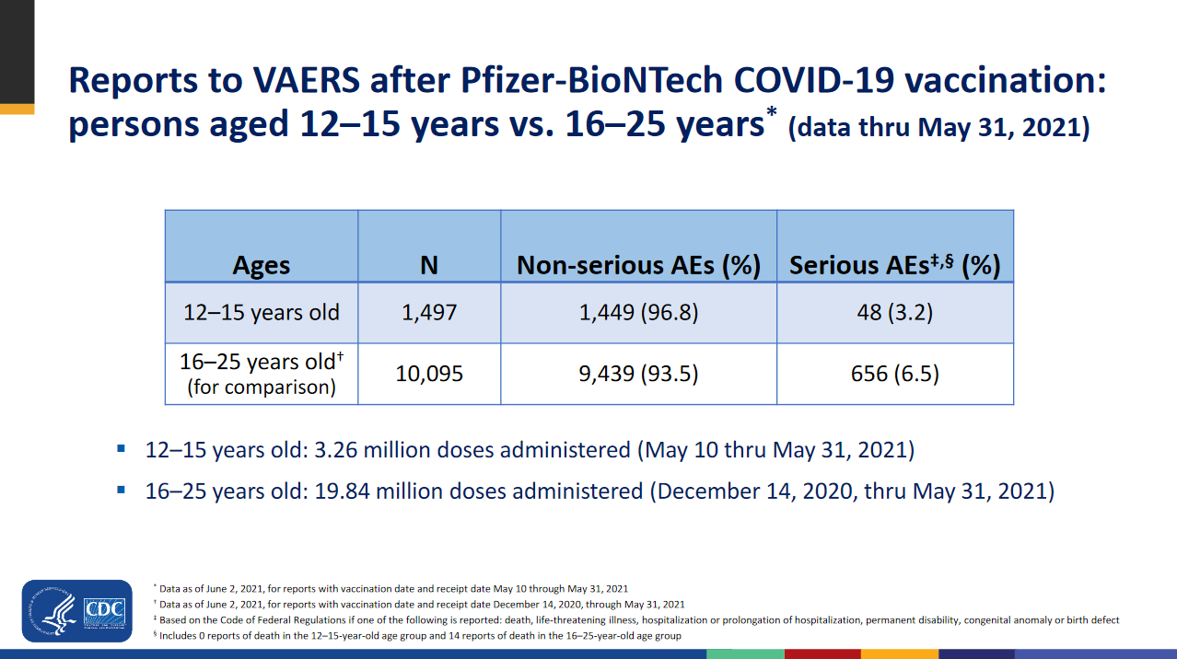

Slide 12
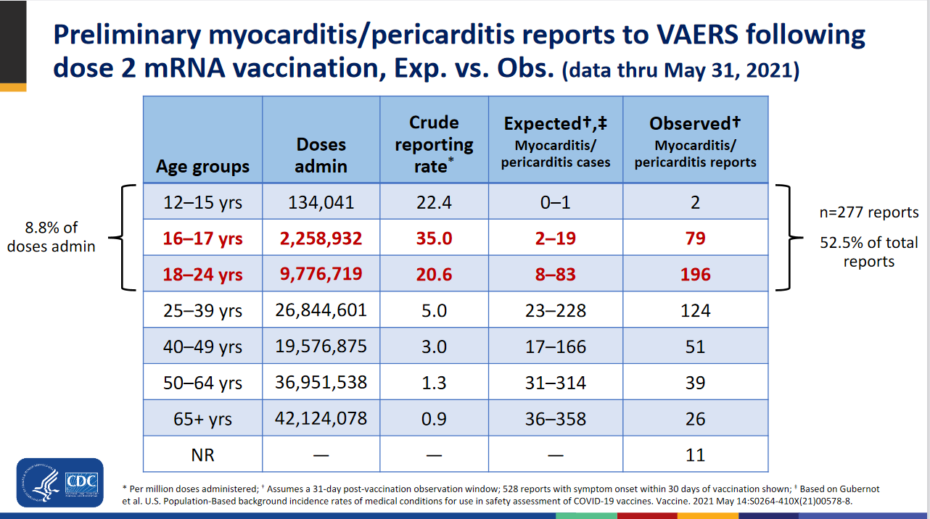

Slide 13
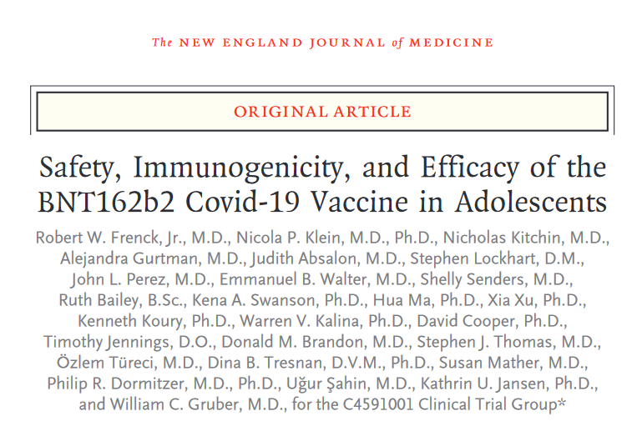
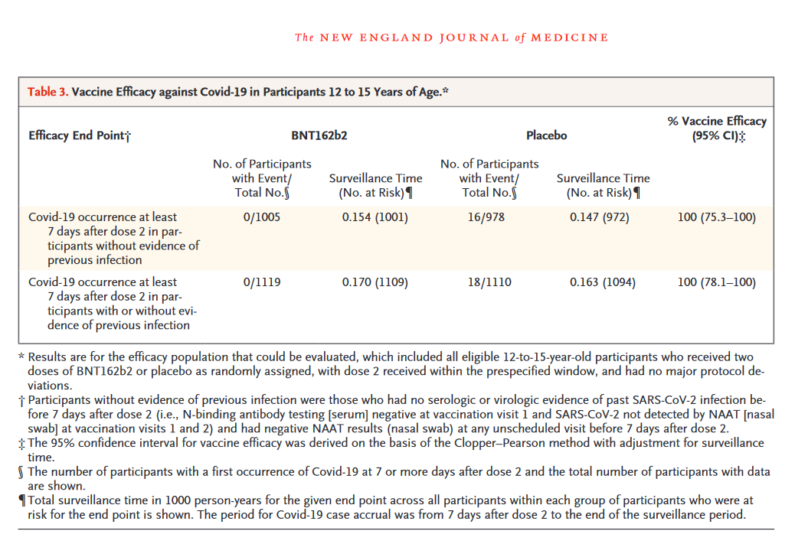

Slide 14
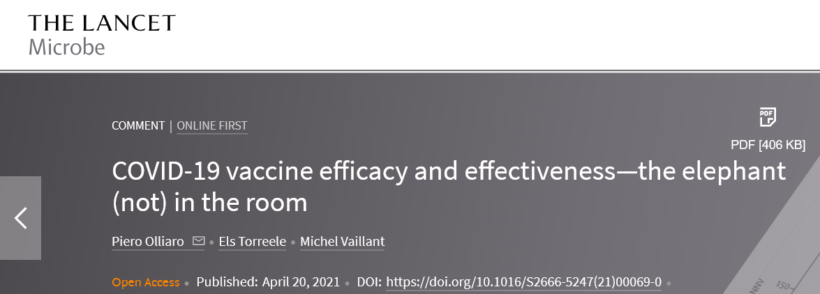
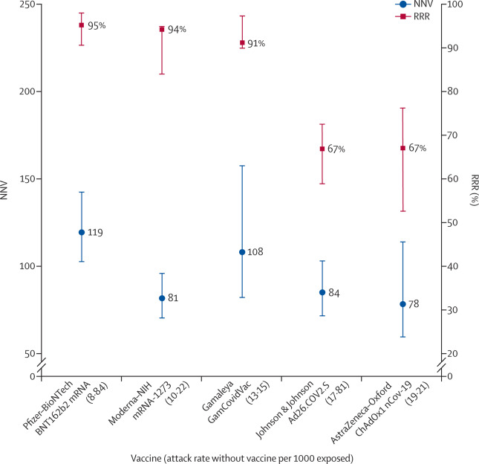
Vaccine efficacy is generally reported as a relative risk reduction (RRR). It uses the relative risk (RR)—ie, the ratio of attack rates with and without a vaccine—which is expressed as 1–RR. Ranking by reported efficacy gives relative risk reductions of 95% for the Pfizer–BioNTech, 94% for the Moderna–NIH, 91% for the Gamaleya, 67% for the J&J, and 67% for the AstraZeneca–Oxford vaccines. However, RRR should be seen against the background risk of being infected and becoming ill with COVID-19, which varies between populations and over time. Although the RRR considers only participants who could benefit from the vaccine, the absolute risk reduction (ARR), which is the difference between attack rates with and without a vaccine, considers the whole population. ARRs tend to be ignored because they give a much less impressive effect size than RRRs: 1·3% for the AstraZeneca–Oxford, 1·2% for the Moderna–NIH, 1·2% for the J&J, 0·93% for the Gamaleya, and 0·84% for the Pfizer–BioNTech vaccines.

Slide 15
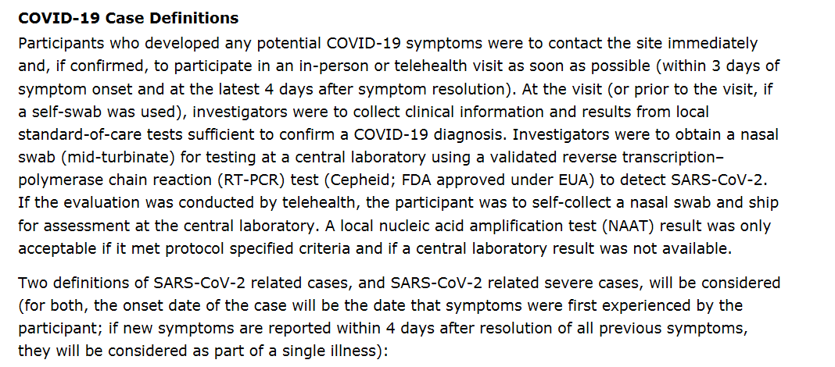
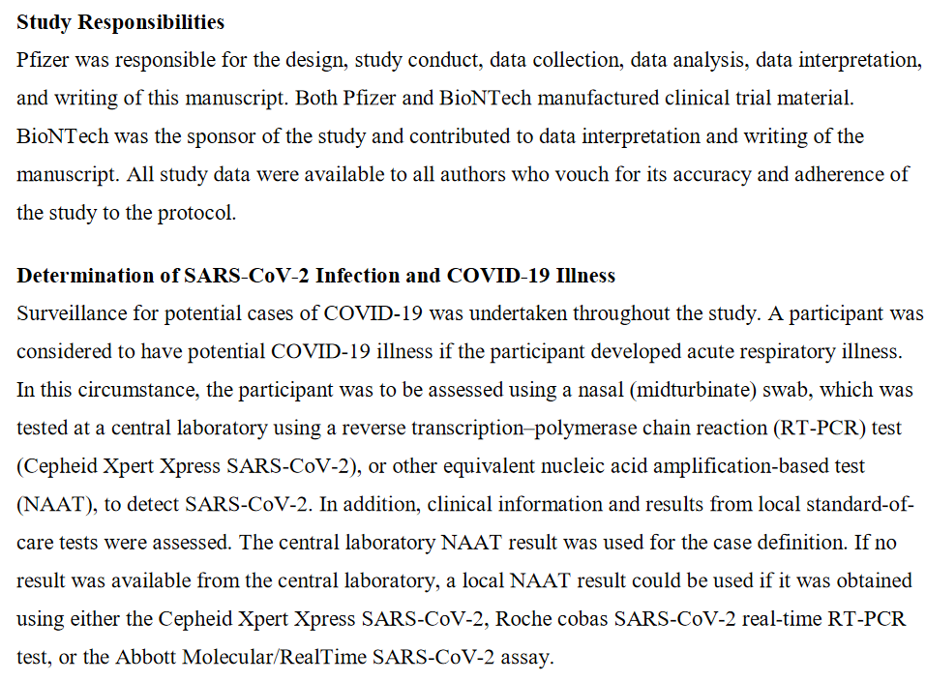
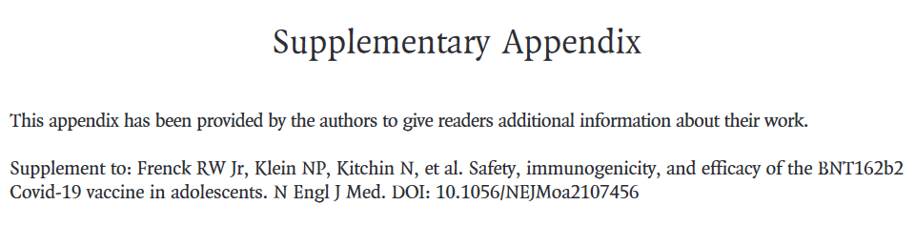

Slide 16
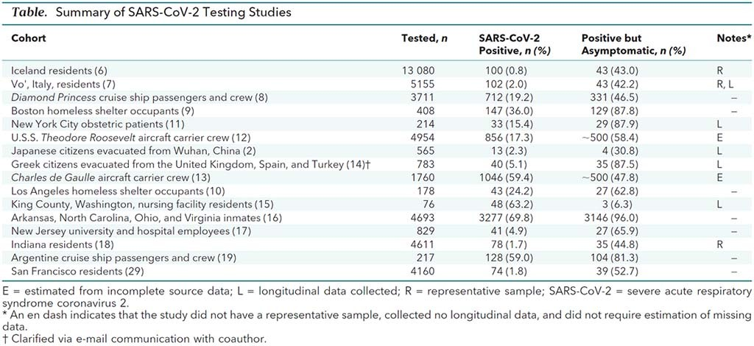
https://doi.org/10.7326/M20-3012

Slide 17
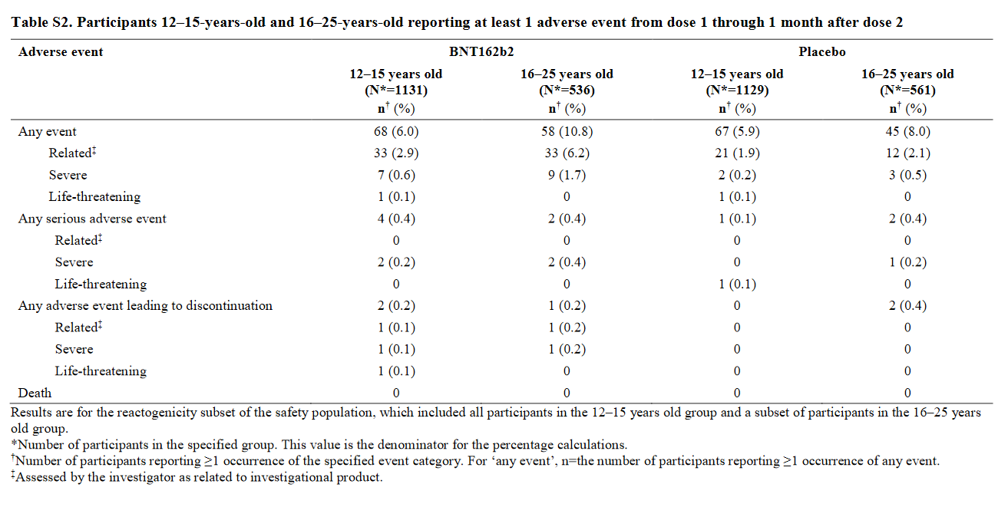

Slide 18
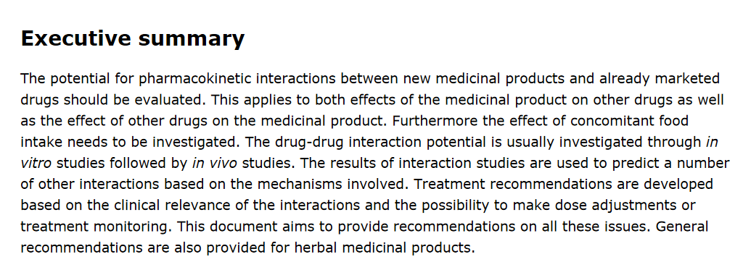
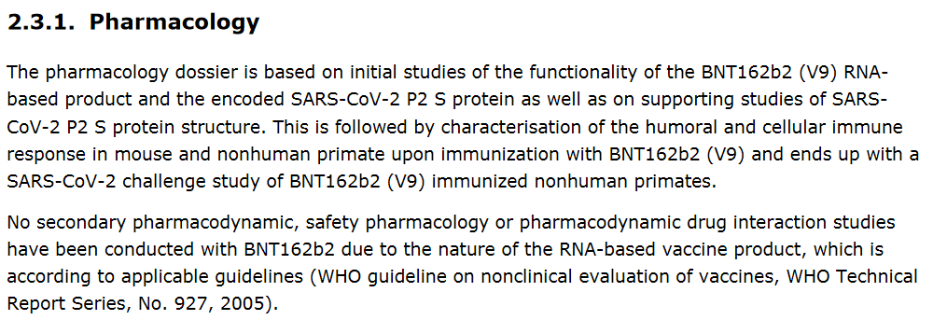
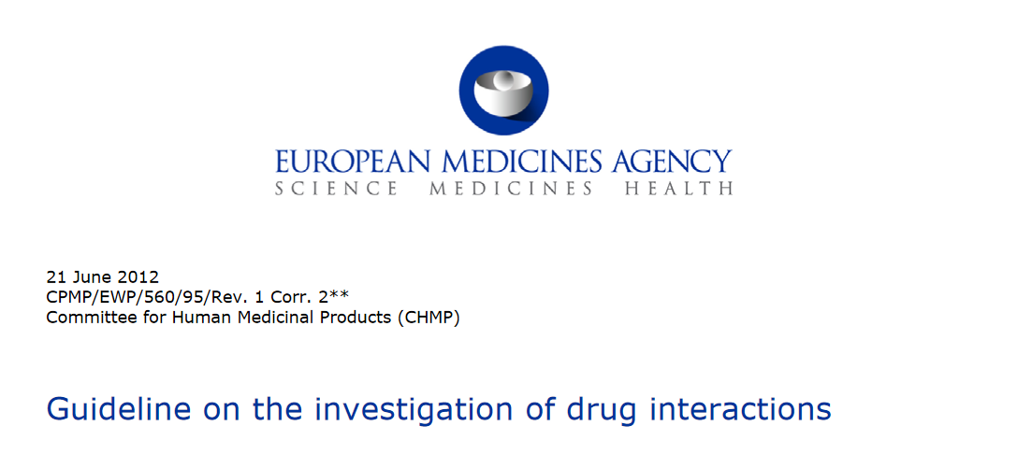
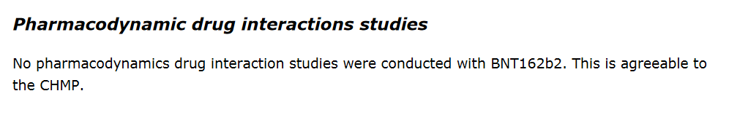
1) Pharmacokinetic Interactions
https://www.ema.europa.eu/en/documents/scientific-guideline/guideline-investigation-drug-interactions-revision-1_en.pdf

Slide 19
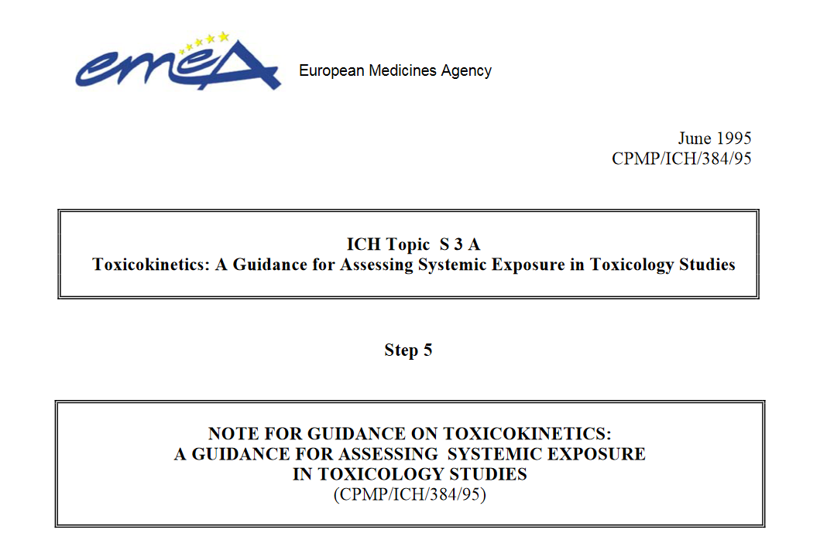
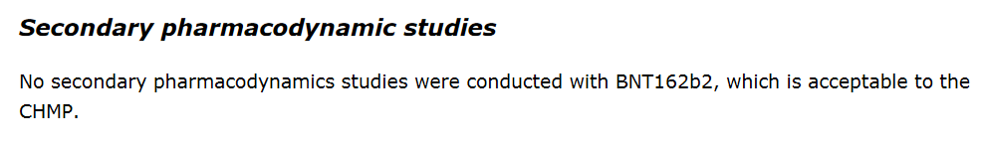
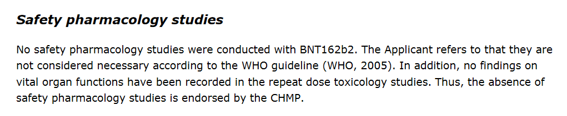
2) Toxicokinetics
https://www.ema.europa.eu/en/documents/scientific-guideline/ich-s-3-toxicokinetics-guidance-assessing-systemic-exposure-toxicology-studies-step-5_en.pdf
“Toxicokinetics is thus an integral part of the non-clinical testing programme; it should enhance the value of the toxicological data generated, both in terms of understanding the toxicity tests and in comparison with clinical data as part of the assessment of risk and safety in humans. Due to its integration into toxicity testing and its bridging character between non-clinical and clinical studies, the focus is primarily on the interpretation of toxicity tests and not on characterising the basic pharmacokinetic parameters of the substance studied. As the development of a pharmaceutical product is a dynamic process which involves continuous feed-back between non-clinical and clinical studies, no rigid detailed procedures for the application of toxicokinetics are recommended. It may not be necessary for toxicokinetic data to be collected in all studies and scientific judgement should dictate when such data may be useful.”

Slide 20
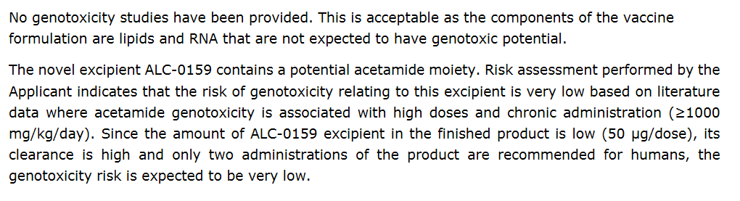
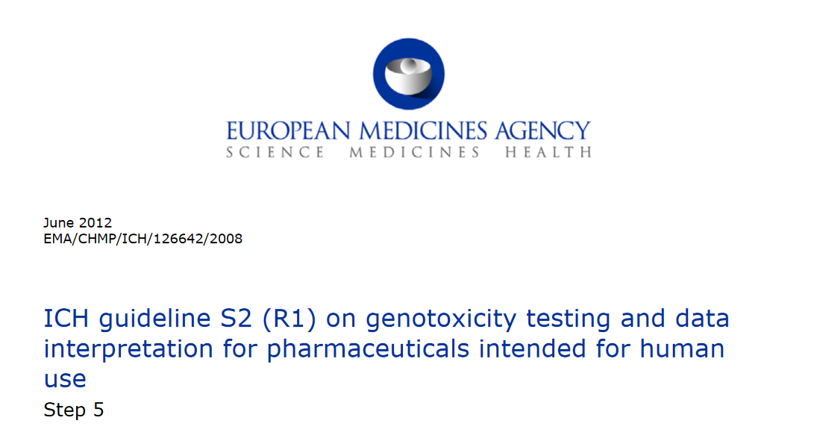
3) Genotoxicity
https://www.ema.europa.eu/en/documents/scientific-guideline/ich-guideline-s2-r1-genotoxicity-testing-data-interpretation-pharmaceuticals-intended-human-use-step_en.pdf
Genotoxicity tests can be defined as in vitro and in vivo tests designed to detect compounds that induce genetic damage by various mechanisms. These tests enable hazard identification with respect to damage to DNA and its fixation. Fixation of damage to DNA in the form of gene mutations, larger scale chromosomal damage or recombination is generally considered to be essential for heritable effects and in the multi-step process of malignancy, a complex process in which genetic changes might possibly play only a part. Numerical chromosome changes have also been associated with tumorigenesis and can indicate a potential for aneuploidy in germ cells. Compounds that are positive in tests that detect such kinds of damage have the potential to be human carcinogens and/or mutagens. Because the relationship between exposure to particular chemicals and carcinogenesis is established for humans, whilst a similar relationship has been difficult to prove for heritable diseases, genotoxicity tests have been used mainly for the prediction of carcinogenicity. Nevertheless, because germ line mutations are clearly associated with human disease, the suspicion that a compound might induce heritable effects is considered to be just as serious as the suspicion that a compound might induce cancer. In addition, the outcome of genotoxicity tests can be valuable for the interpretation of carcinogenicity studies.

Slide 21
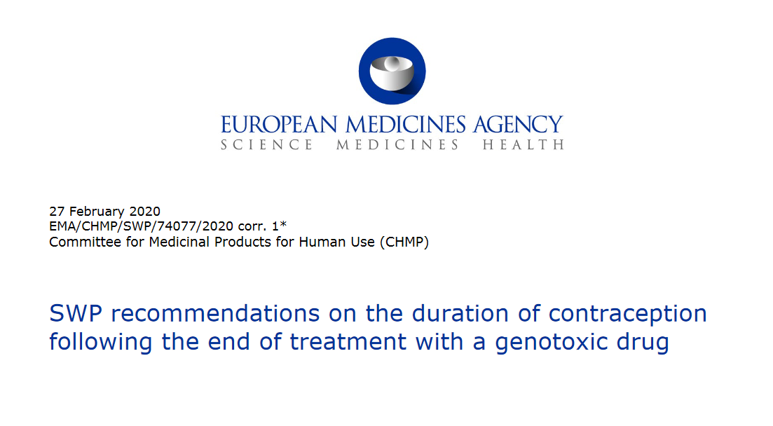
Is it important?
“Genetic alterations in somatic and germ cells may play a part in serious health effects, which in principle may occur even with low exposures to certain medicinal products. Mutations in germ cells can lead to spontaneous abortions, infertility or heritable damage to the offspring and possibly to the subsequent generations. To minimise the risk of drug-induced heritable DNA damage and to ensure that genomic integrity of gametes at the time of conception is maintained, patients are generally advised to use highly effective contraception during treatment and for an adequate period of time following the end of treatment with genotoxic drugs. Therefore, clear guidance should be provided by regulators and pharmaceutical companies to healthcare professionals and patients in order to determine the appropriate duration of contraception.”

Slide 22
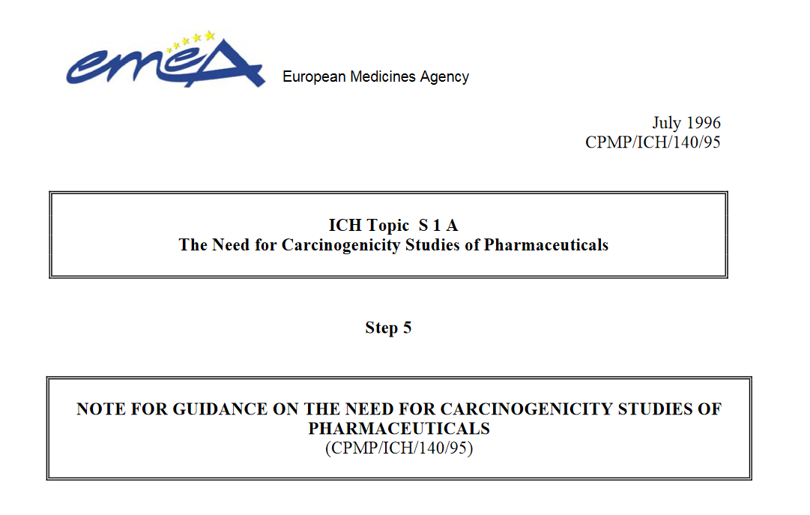
Carcinogenicity
The objectives of carcinogenicity studies are to identify a tumorigenic potential in animals and to assess the relevant risk in humans, Any cause for concern derived from laboratory investigations, animal toxicology studies, and data in humans may lead to a need for carcinogenicity studies. The practice of requiring carcinogenicity studies in rodents was instituted for pharmaceuticals that were expected to be administered regularly over a substantial part of a patient's lifetime. The design and interpretation of the results from these studies preceded much of the available current technology to test for genotoxic potential and the more recent advances in technologies to assess systemic exposure. These studies also preceded our current understanding of tumorigenesis with non-genotoxic agents. Results from genotoxicity studies, toxicokinetics, and mechanistic studies can now be routinely applied in preclinical safety assessment. These additional data are important not only in considering whether to perform carcinogenicity studies but for interpreting study outcomes with respect to relevance for human safety. Since carcinogenicity studies are time consuming and resource intensive they should only be performed when human exposure warrants the need for information from life-time studies in animals in order to assess carcinogenic potential.

Slide 23
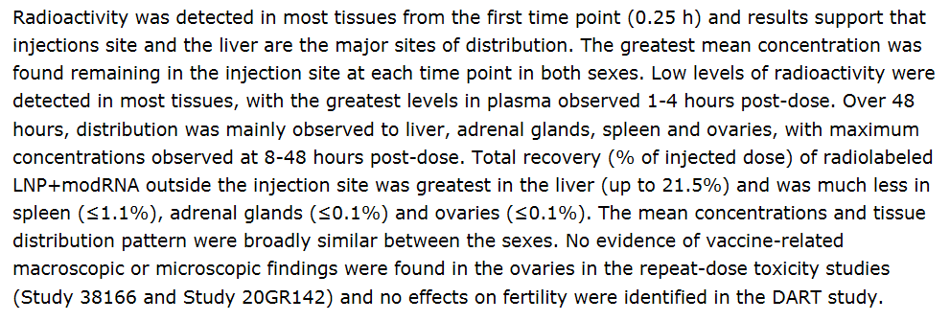
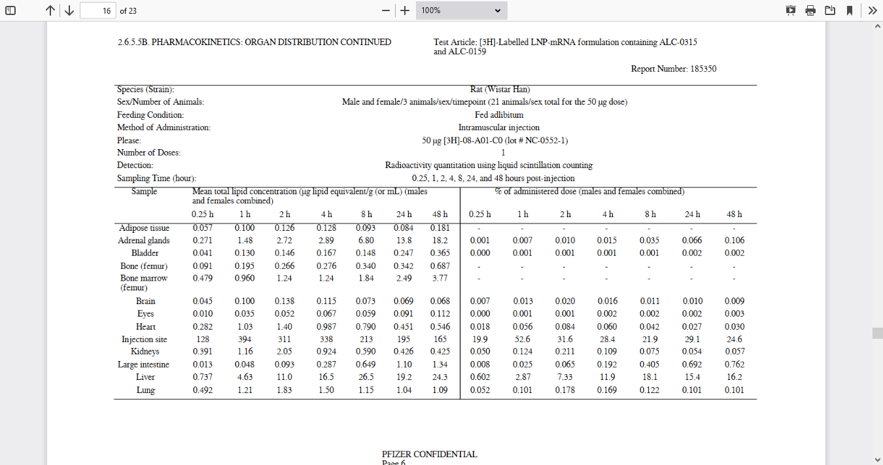
Biodistribtion in animal model

Slide 24
